Slide 1
Design Patterns
Course | Design Patterns
Trainer | Tin Bui
Designed by | Tin Bui
Last updated | May 17, 2010

Slide 2
Contents
What is Design Patterns?
Singleton
Factory method
Abstract Factory
Observer
Command
Exercises

Slide 3
Course Objectives
Understand What Design Patterns is
Understand the most basic patterns
Apply Design Pattern in programming

Slide 4
Why trainees should learn this topic?
Reuse solutions
Establish common terminology
Patterns give you a higher-level perspective on the problem and on the process of design

Slide 5
Contents
What is Design Patterns?
Singleton
Factory method
Abstract Factory
Observer
Command
Exercises

Slide 6
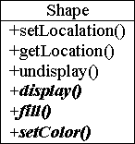




An Example
Shape

Slide 7
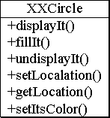
An Example (cont.)
Shape
?

Slide 8
An Example (cont.)
Shape
Target
Adapter
Adaptee
Circle
- c : XXCircle
+ setLocation() + getLocation() + undisplay() + display() + fill() + setColor()
1
1

Slide 9
What is Design Pattern?
A design pattern offers guidelines on when, how, and why an implementation can be created to solve a general problem in a particular context.
“Design patterns help you learn from others' successes instead of your own failures.”
From Mark Johnson.

Slide 10
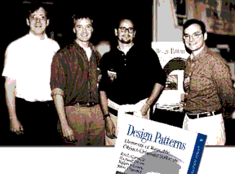
History of Design Patterns
Gamma, Helm, Vlissides,
and Johnson
... the Gang of Four (GOF)
In 1995, published their now famous book titled "Design Patterns, Elements of Reusable Object-Oriented Software"
GOF cataloged software design patterns and brought these concepts into the mainstream

Slide 11
Design Patterns
Solutions to commonly occurring design problems
Help create flexible and reusable designs
Isolate changes in your code
Larger scope than a single class or algorithm
Describes the circumstances in which the pattern is applicable
Language Independent

Slide 12
Essential Properties of a Pattern
Pattern Name
Motivation
  Problem
    Describes a situation
  Solution
    Describes the elements that make up the design
    Their relationships, responsibilities, and collaborations
Applicability
  When is the pattern applied?
Consequences
  The costs and benefits of applying the pattern

Slide 13
How Can Patterns Be Applied?
A program can apply many patterns
A pattern can be applied in many different parts
Many patterns can be used together

Slide 14
Design Pattern Categories (cont.)
 |  | Purpose
 |  | Creational | Structural | Behavioral
 | Class | Factory Method | Adapter | Interpreter Template Method
 | Object | Abstract Factory Builder Prototype Singleton | Adapter Bridge Composite Decorator Facade Proxy | Chain of Responsibility Command Iterator Mediator Memento Flyweight Observer State Strategy Visitor
Relationship

Slide 15
Object Pattern Example
Shape
Circle
- c : XXCircle
+ setLocation() + getLocation() + undisplay() + display() + fill() + setColor()
1
1

Slide 16
Class Pattern Example
Shape
Circle
+ setLocation() + getLocation() + undisplay() + display() + fill() + setColor()

Slide 17
Frequency of Use
Creational Patterns
Pattern | Description | Freq
Abstract Factory | Creates an instance of several families of classes | 5
Builder | Separates object construction from its representation | 2
Factory Method | Creates an instance of several derived classes | 5
Prototype | A fully initialized instance to be copied or cloned | 3
Singleton | A class of which only a single instance can exist | 4

Slide 18
Frequency of Use
Structural Patterns
Pattern | Description | Freq
Adapter | Match interfaces of different classes | 4
Bridge | Separates an object’s interface from its implementation | 3
Composite | A tree structure of simple and composite objects | 4
Decorator | Add responsibilities to objects dynamically | 3
Facade | A single class that represents an entire subsystem | 5
Flyweight | A fine-grained instance used for efficient sharing | 1
Proxy | An object representing another object | 4

Slide 19
Frequency of Use
Behavioral Patterns
Pattern | Description | Freq
Chain of Resp. | A way of passing a request between a chain of objects | 2
Command | Encapsulate a command request as an object | 4
Interpreter | A way to include language elements in a program | 1
Iterator | Sequentially access the elements of a collection | 5
Mediator | Defines simplified communication between classes | 2
Memento | Capture and restore an object's internal state | 1

Slide 20
Frequency of Use
Behavioral Patterns (cont.)
Pattern | Description | Freq
Observer | A way of notifying change to a number of classes | 5
State | Alter an object's behavior when its state changes | 3
Strategy | Encapsulates an algorithm inside a class | 4
Template Method | Defer the exact steps of an algorithm to a subclass | 3
Visitor | Defines a new operation to a class without change | 1

Slide 21
Contents
What is Design Patterns?
Singleton
Factory method
Abstract Factory
Observer
Command
Exercises

Slide 22
Singleton
Intent
Ensure a class only has one instance
  E.g.
  Class to contain the connection between a client and its server
  Class to contain information of current user

Slide 23
Singleton
Structure
MySingleton
- static instance: MySingleton …
- MySingleton() + static getInstance() : MySingleton …
Constructor
must be
private
static getInstance() MySingleton() {
if (instance == null) {
instance = new MySingleton();
}
return instance;
}

Slide 24
Singleton
Applicability
  There must be exactly one instance of a class
  When the sole instance should be extensible by subclassing

Slide 25
Singleton
Consequences
  ☑ Controlled access to sole instance
  ☑ Reduced name space
    Is an improvement over global variables
  ☑ Permits a variable number of instances
  ☑ More flexible than class operations

Slide 26
Contents
What is Design Patterns?
Singleton
Factory method
Abstract Factory
Observer
Command
Exercises

Slide 27
Factory Method
Problem
  Consider a Pizza Store System
  Each store in the system has its own way to create its pizzas

Slide 28
Factory Method
Solution
public abstract class PizzaStore {
public Pizza orderPizza() {
Pizza pizza = createPizza();
bake(pizza);
box(pizza);
return pizza;
}
// factory method
protected abstract Pizza createPizza();
}
public class ChicagoPizzaStore extends PizzaStore {
protected Pizza createPizza() {
return new ChicagoPizza();
}
}

Slide 29
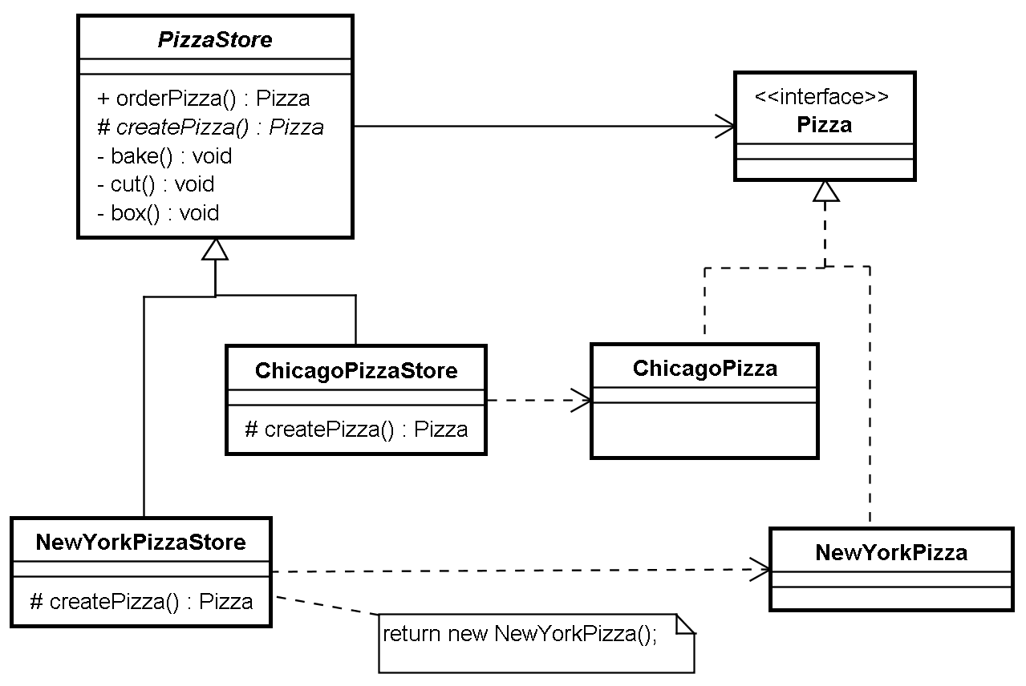
Factory Method
Solution

Slide 30
Factory Method
Intent
  Define an interface for creating an object
  Let subclasses decide which class to instantiate

Slide 31
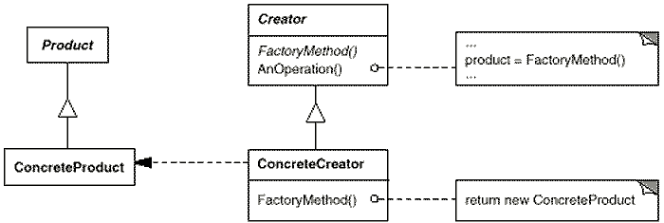
Factory Method
Structure

Slide 32
Factory Method
Participants
  Product (Pizza)
    Defines the interface of objects the factory method creates.
  ConcreteProduct (ChicagoPizza)
    Implements the Product interface.
  Creator (PizzaStore)
    Declares the factory method, which returns an object of type Product
    May also define a default implementation of the factory method that returns a default ConcreteProduct object.
    May call the factory method to create a Product object.
  ConcreteCreator (ChicagoPizzaStore)
    Overrides the factory method to return an instance of a ConcreteProduct.

Slide 33
Factory Method
Applicability
  A class can't anticipate the class of objects it must create
  A class wants its subclasses to specify the objects it creates

Slide 34
Factory Method
Consequences
  ☑ Provides hooks for subclasses
  ☑ Connects parallel class hierarchies

Slide 35
Contents
What is Design Patterns?
Singleton
Factory method
Abstract Factory
Observer
Command
Exercises

Slide 36
Abstract Factory
Problem
  Update your Pizza Store System to support many types of products

Slide 37
Abstract Factory
Solution
  Temporary solution
public abstract class PizzaStore {
public Pizza orderPizza() {
Pizza pizza = createPizza();
bake(pizza);
box(pizza);
return pizza;
}
public Hotdog orderHotdog() {
Hotdog hotdog = createHotdog();
bake(hotdog);
box(hotdog);
return hotdog;
}
// factory method
protected abstract Pizza createPizza();
protected abstract Hotdog createHotdog();
}

Slide 38
Abstract Factory
Solution – temporary solution
public abstract class PizzaStore {
public Pizza orderPizza() {
Pizza pizza = createPizza();
bake();
box();
return pizza;
}
public Pizza orderHotdog() {
Pizza pizza = createHotdog();
bake();
box();
return pizza;
}
}
Public class PizzaStore {
FoodFactory factory;
public PizzaStore(FoodFactory factory) {
this.factory = factory;
}
public Pizza orderPizza() {
Pizza pizza = factory.createPizza();
bake(pizza);
box(pizza);
return pizza;
}
public Hotdog orderHotdog() {
Hotdog hotdog = factory.createHotdog();
bake(hotdog);
box(hotdog);
return hotdog;
}
}
interface FoodFactory {
Pizza createPizza();
Hotdog createHotdog();
}
protected abstract Pizza createPizza();
protected abstract Pizza createHotdog();

Slide 39
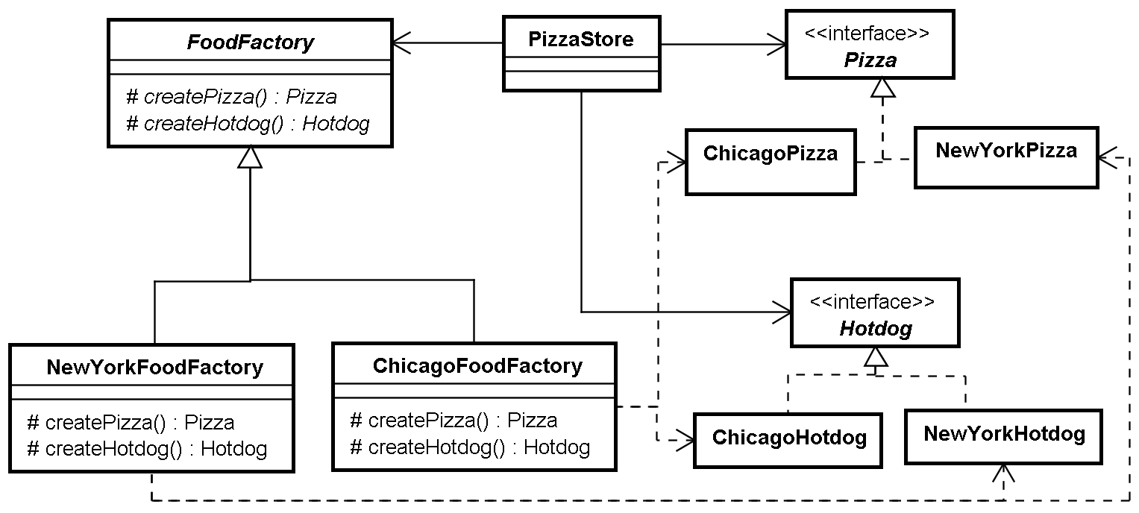
Abstract Factory
Solution

Slide 40
Abstract Factory
Intent
  Provide an interface for creating families of related or dependent objects without specifying their concrete classes

Slide 41

Abstract Factory
Structure

Slide 42
Abstract Factory
Applicability
  A system should be independent of how its products are created, composed, and represented
  A system should be configured with one of multiple families of products
  A family of related product objects is designed to be used together, and you need to enforce this constraint
  You want to provide a class library of products, and you want to reveal just their interfaces, not their implementations

Slide 43
Abstract Factory
Consequences
  ☑ Isolates concrete classes
    Isolates clients from implementation classes
    Clients manipulate instances through their abstract interfaces
  ☑ Makes exchanging product families easy
  ☑ Promotes consistency among products
    Enforce application to use objects from only one family at a time
  ☒ Supporting new kinds of products is difficult
    Supporting new kinds of products requires extending the factory interface

Slide 44
Contents
What is Design Patterns?
Singleton
Factory method
Abstract Factory
Observer
Command
Exercises

Slide 45
Observer
Intent
  Define a one-to-many dependency between objects so that when one object changes state, all its dependents are notified and updated automatically

Slide 46
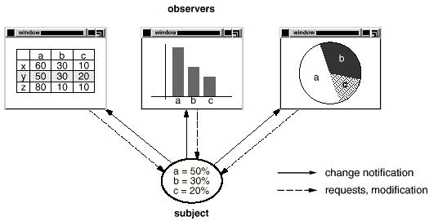
Observer
Problem
  Need to maintain consistency between related objects
  Don't want to achieve consistency by making the classes tightly coupled
  Example:

Slide 47
Observer
Solution
// View is an interface
// Notify these guys
// if data change
View[] observers;
a=50%
b=30%
c=20%

Slide 48
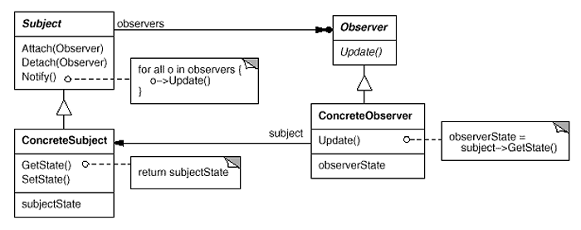
Observer
Structure

Slide 49
Observer
Participants
  Subject
    Knows its observers
    Provides an interface for attaching and detaching Observer objects
  Observer
    Defines an updating interface for objects that should be notified of changes in a subject
  ConcreteSubject
    Stores state of interest to ConcreteObserver objects
    Sends a notification to its observers when its state changes
  ConcreteObserver
    Maintains a reference to a ConcreteSubject object
    Stores state that should stay consistent with the subject's

Slide 50
Observer
Applicability
  When an abstraction has two aspects, one dependent on the other
    Encapsulating these aspects in separate objects lets you vary and reuse them independently.
  When a change to one object requires changing others
  When an object should be able to notify other objects without making assumptions about who these objects are
    In other words, you don't want these objects tightly coupled

Slide 51
Observer
Consequences
  ☑ Abstract coupling between Subject and Observer
  ☑ Support for broadcast communication
  ☒ Unexpected updates

Slide 52
Observer
Observer Pattern in java
  java.util.Observable class
  java.util.Observer interface

Slide 53
Contents
What is Design Patterns?
Singleton
Factory method
Abstract Factory
Observer
Command
Exercises

Slide 54
Command
Problem
  Need issue requests to objects without knowing operation being requested
  For example, user interface toolkits include objects like buttons and menus that carry out a request in response to user input. But the toolkit can't implement the request explicitly in the button or menu, because only applications that use the toolkit know what should be done on which object. As toolkit designers we have no way of knowing the receiver of the request or the operations that will carry it out

Slide 55
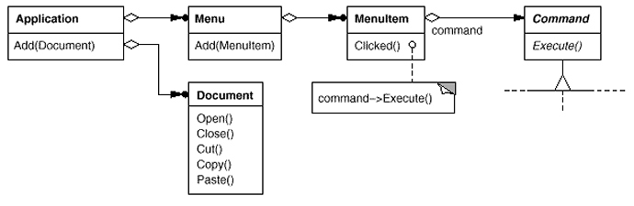
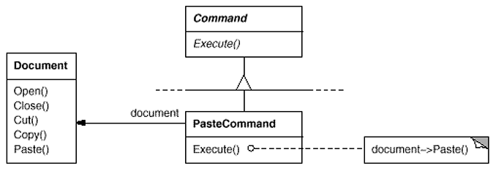
Command
Solution

Slide 56
Command
Intent
  Encapsulate a request as an object
  Letting you parameterize clients with different requests
  Queue or log requests
  Support undoable operations

Slide 57
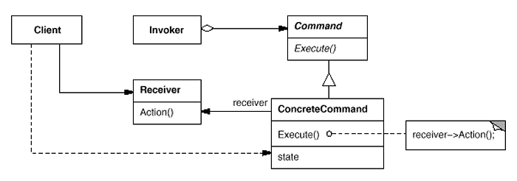
Command
Structure

Slide 58
Command
Applicability
  Parameterize objects by an action to perform
  Specify, queue, and execute requests at different times
  Support undo
    must have an added Unexecute operation that reverses the effects of a previous call to Execute
  Support logging changes so that they can be reapplied in case of a system crash

Slide 59
Command
Consequences
  ☑ Decouples the objects
  ☑ Can assemble commands into a composite command
  ☑ Easy to add new Commands

Slide 60
Contents
What is Design Patterns?
Singleton
Factory method
Abstract Factory
Observer
Command
Exercises

Slide 61
Exercises
See Design Pattern Exercises.doc

Slide 62
Summary
Design Patterns help to isolate changes
Easy to maintenance code
  Increase flexibility
  Simplify logic
Standardization
Avoid duplication

Slide 63
References
Design Patterns - Elements of Reusable Object-Oriented Software (Gang of Four (GoF))
Applied Java™ Patterns (Stephen Stelting, Olav Maassen)
Design Patterns Java Workbook (Steven John Metsker)

